Slide 1



[WRO] #4 Workshop Microsoft Azure User Group Poland we Wrocławiu
Michał Jankowski / Piotr Rogala

Slide 2



Slide 3
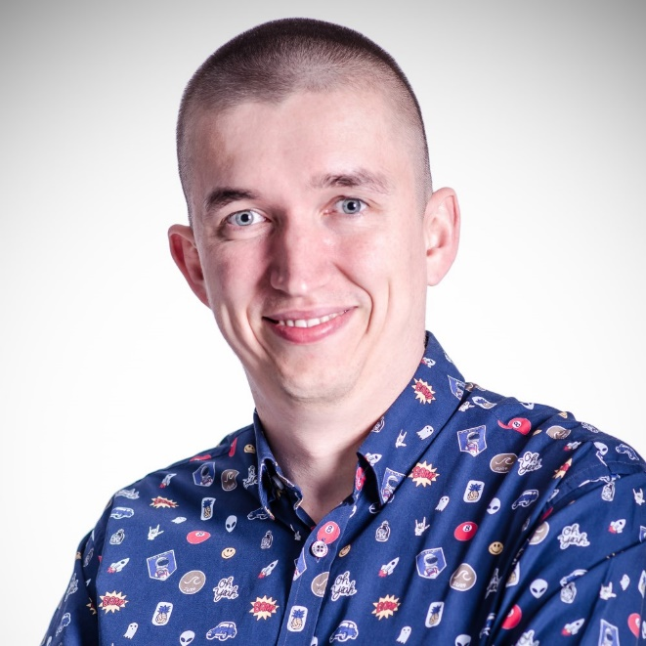


about me
⇩ | architect / software developer / team leader
 | traveller / photographer
✶ | www.jankowskimichal.pl
→ | mail@jankowskimichal.pl
 | @JankowskiMichal
 | github.com/MichalJankowskii
Michał Jankowski

Slide 4
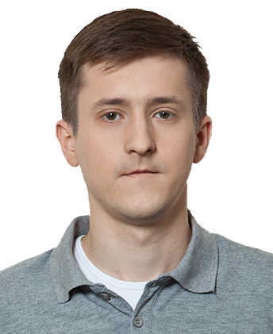


About Me
Current working in Nordcloud
Azure Cloud Architect
MVP Azure
Blog: justcloud.pl
FB Page: facebook.com/justcloudpl
Group leader:
Microsoft Azure User Group Poland

Slide 5

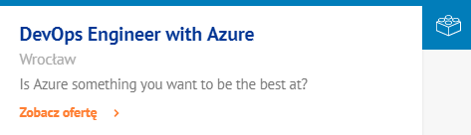
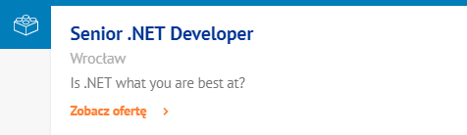
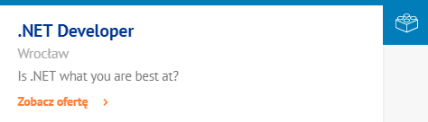
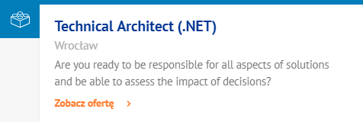
joinus.objectivity.co.uk/

Slide 6
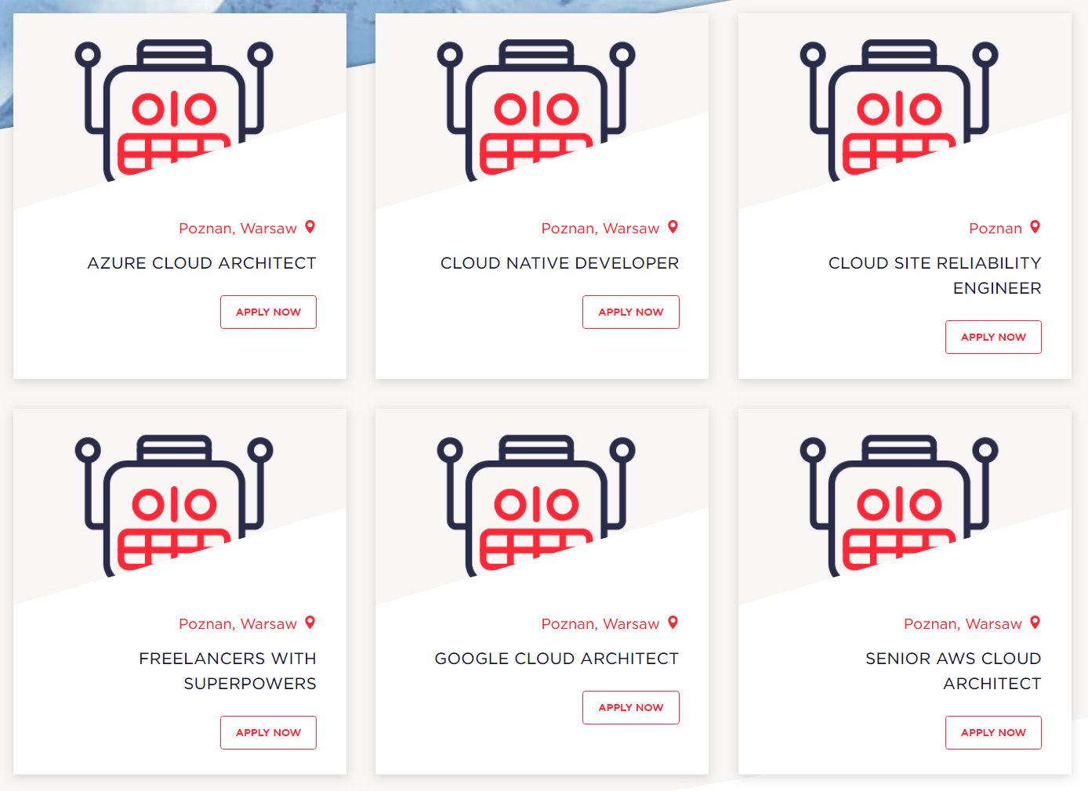
https://nordcloud.com/open-positions/?country-positions=poland

Slide 7
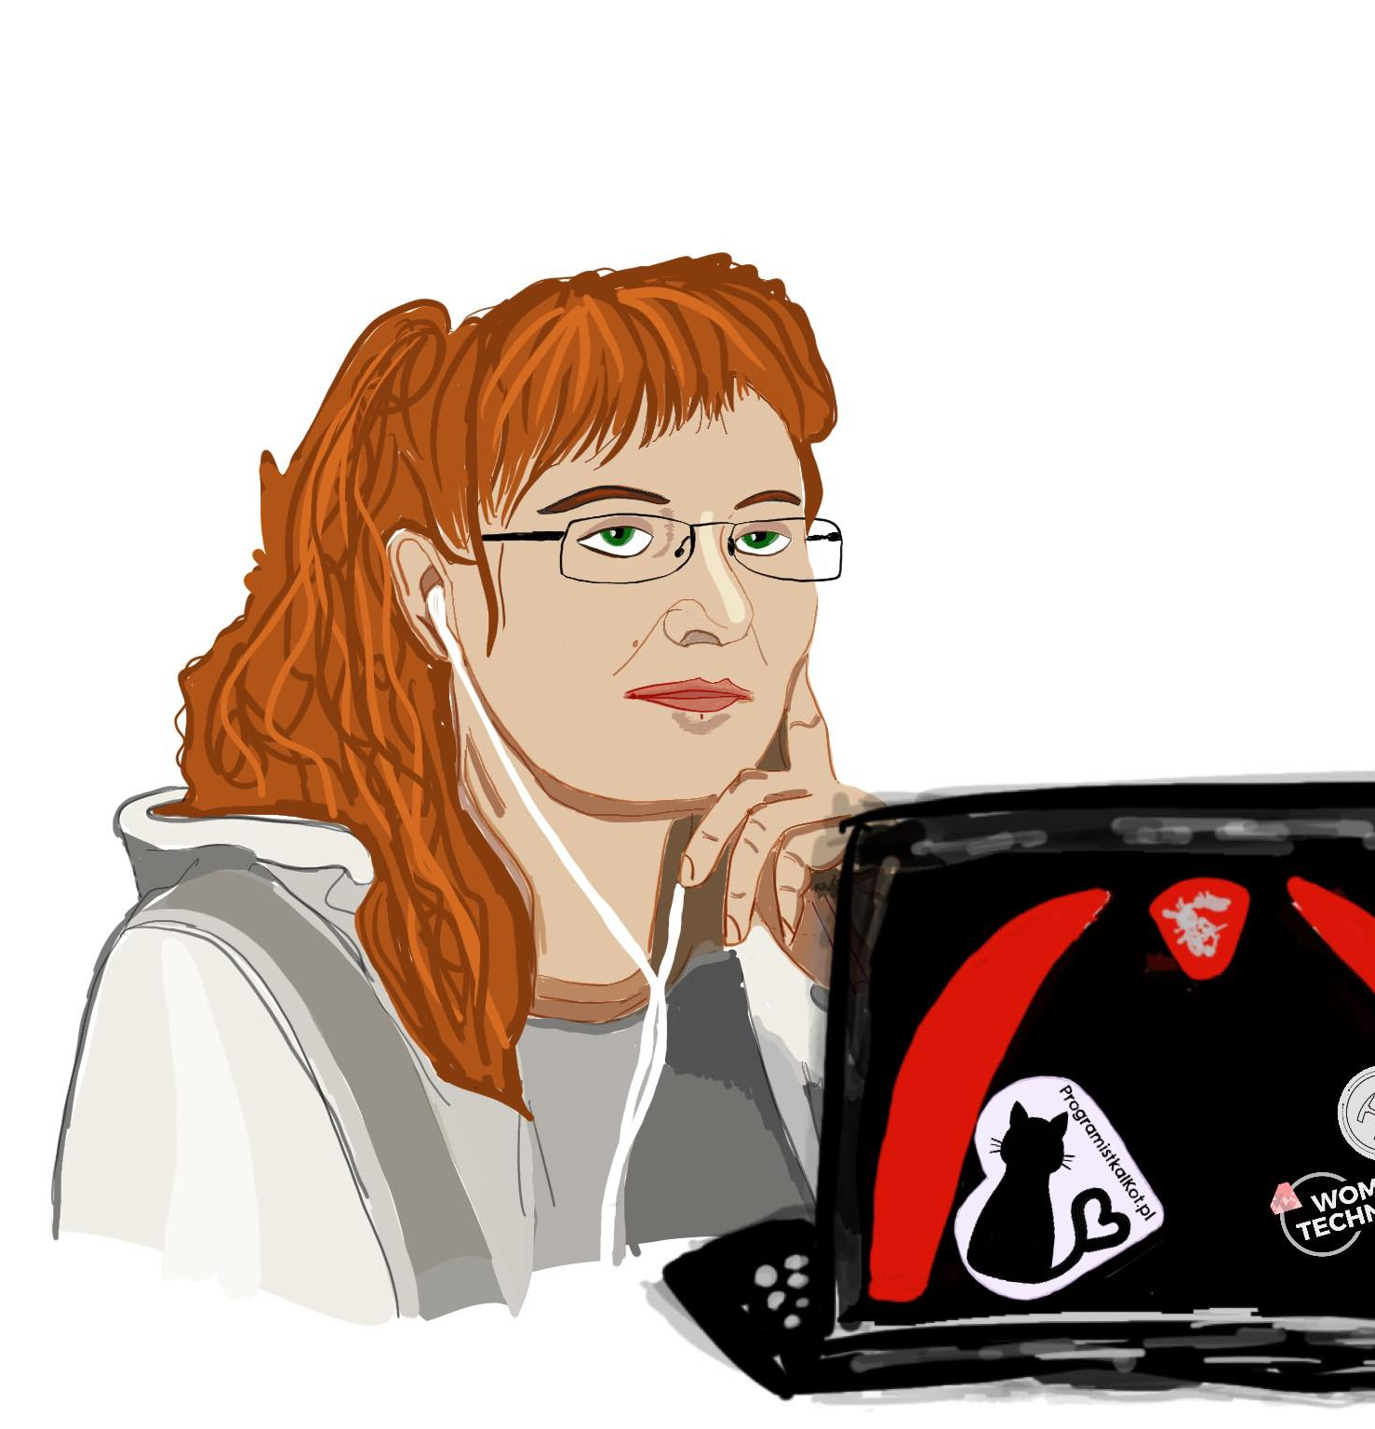
Azure IoT Workshop
Joanna Lamch

